Slide 1
Conflict or Commentary? Comparing Nigerian News Coverage to Boko Haram Conflict Intensity
Zach Einolf | SURV727 Final Project

Slide 2

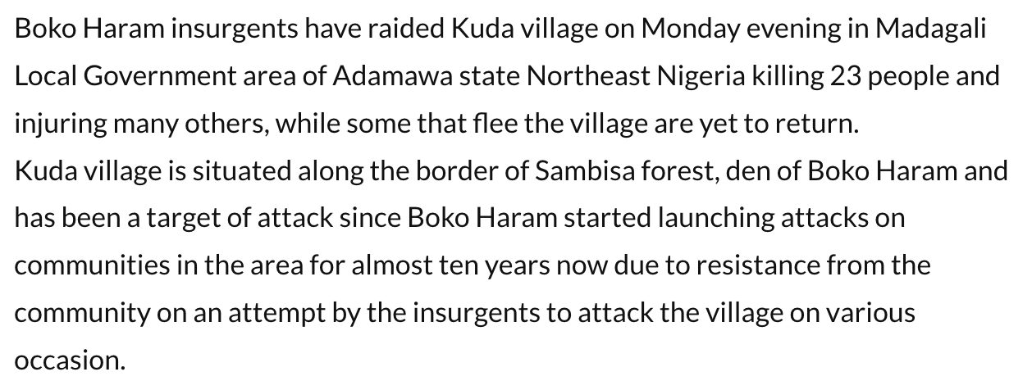
Project Overview
Analysis:
Sentiment Analysis (huggingface)
Times-series plots & visualizations
Analysis of conflict intensity/fatalities
Question:
Does the tone and sentiment of Nigerian news reporting on Boko Haram-orchestrated terrorist attacks align with the actual intensity of said events?
Data:
Armed Conflict Location & Event Data (ACLED) project API
Text data scraped from TheInformant24/7, Mega News, and TheNewsHunter Blog
Source: TheNewsHunter Blog

Slide 3
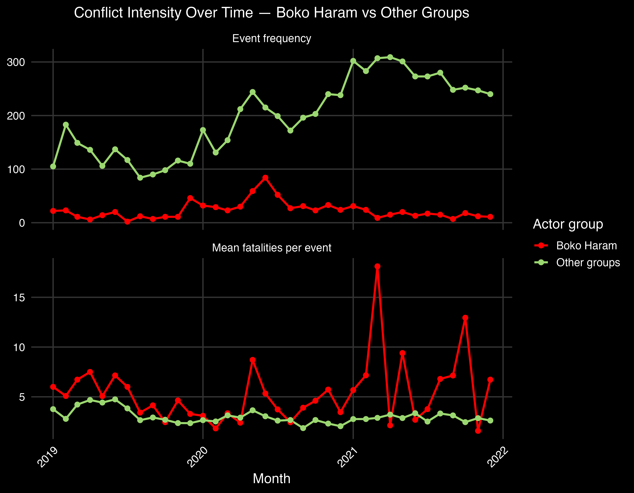
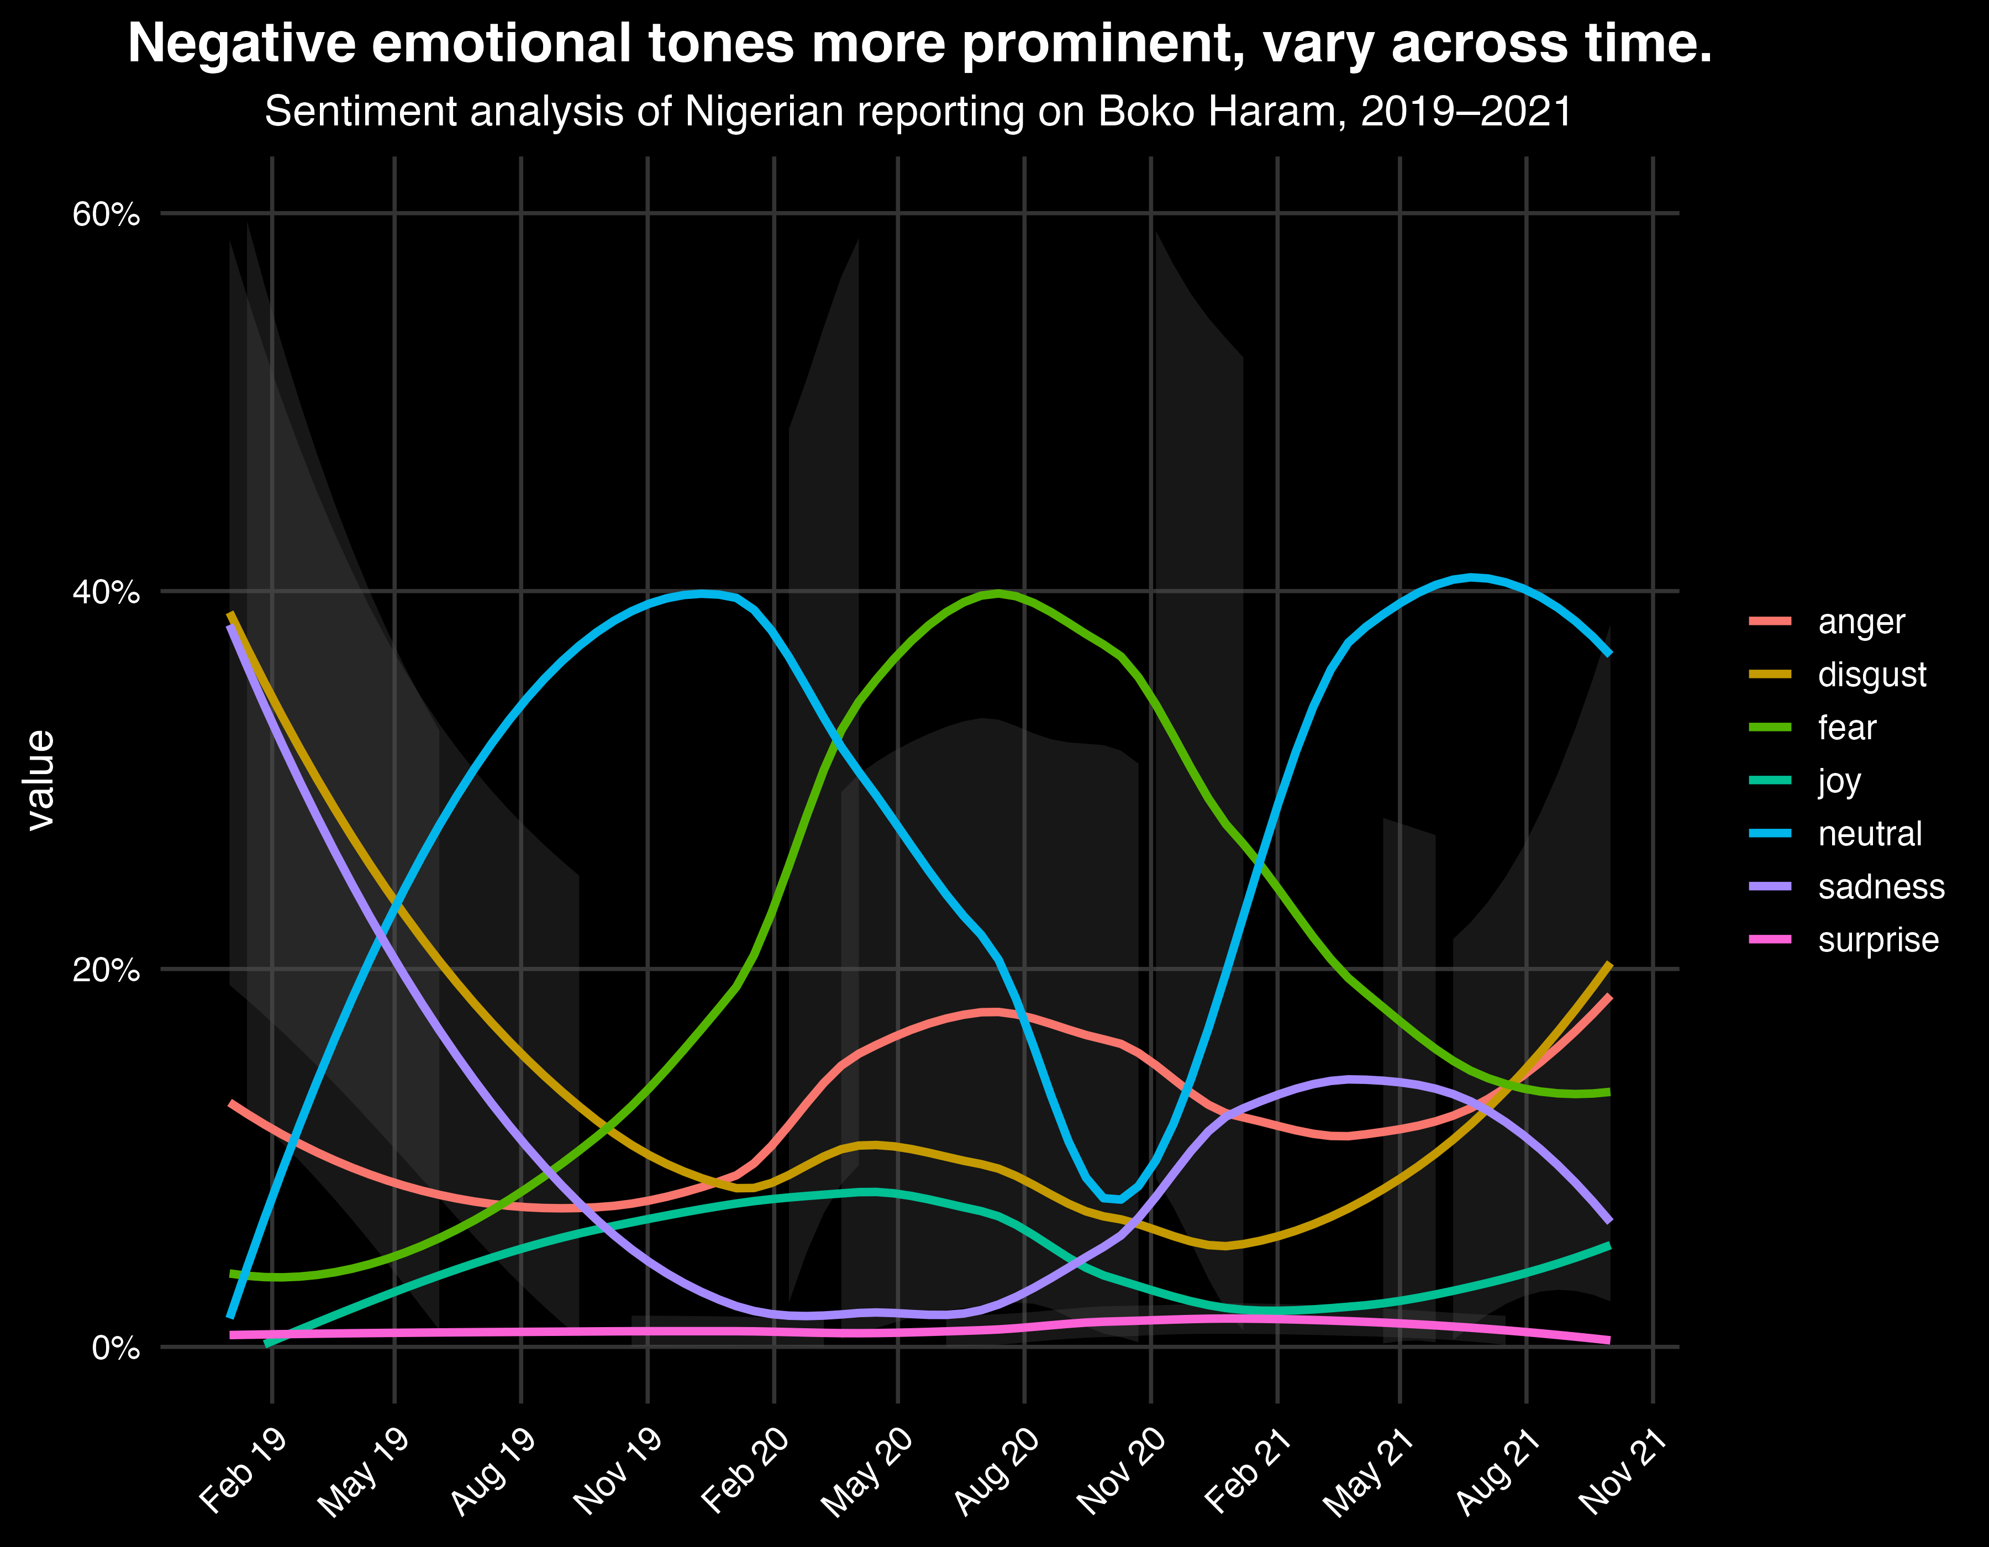
Results

Slide 4
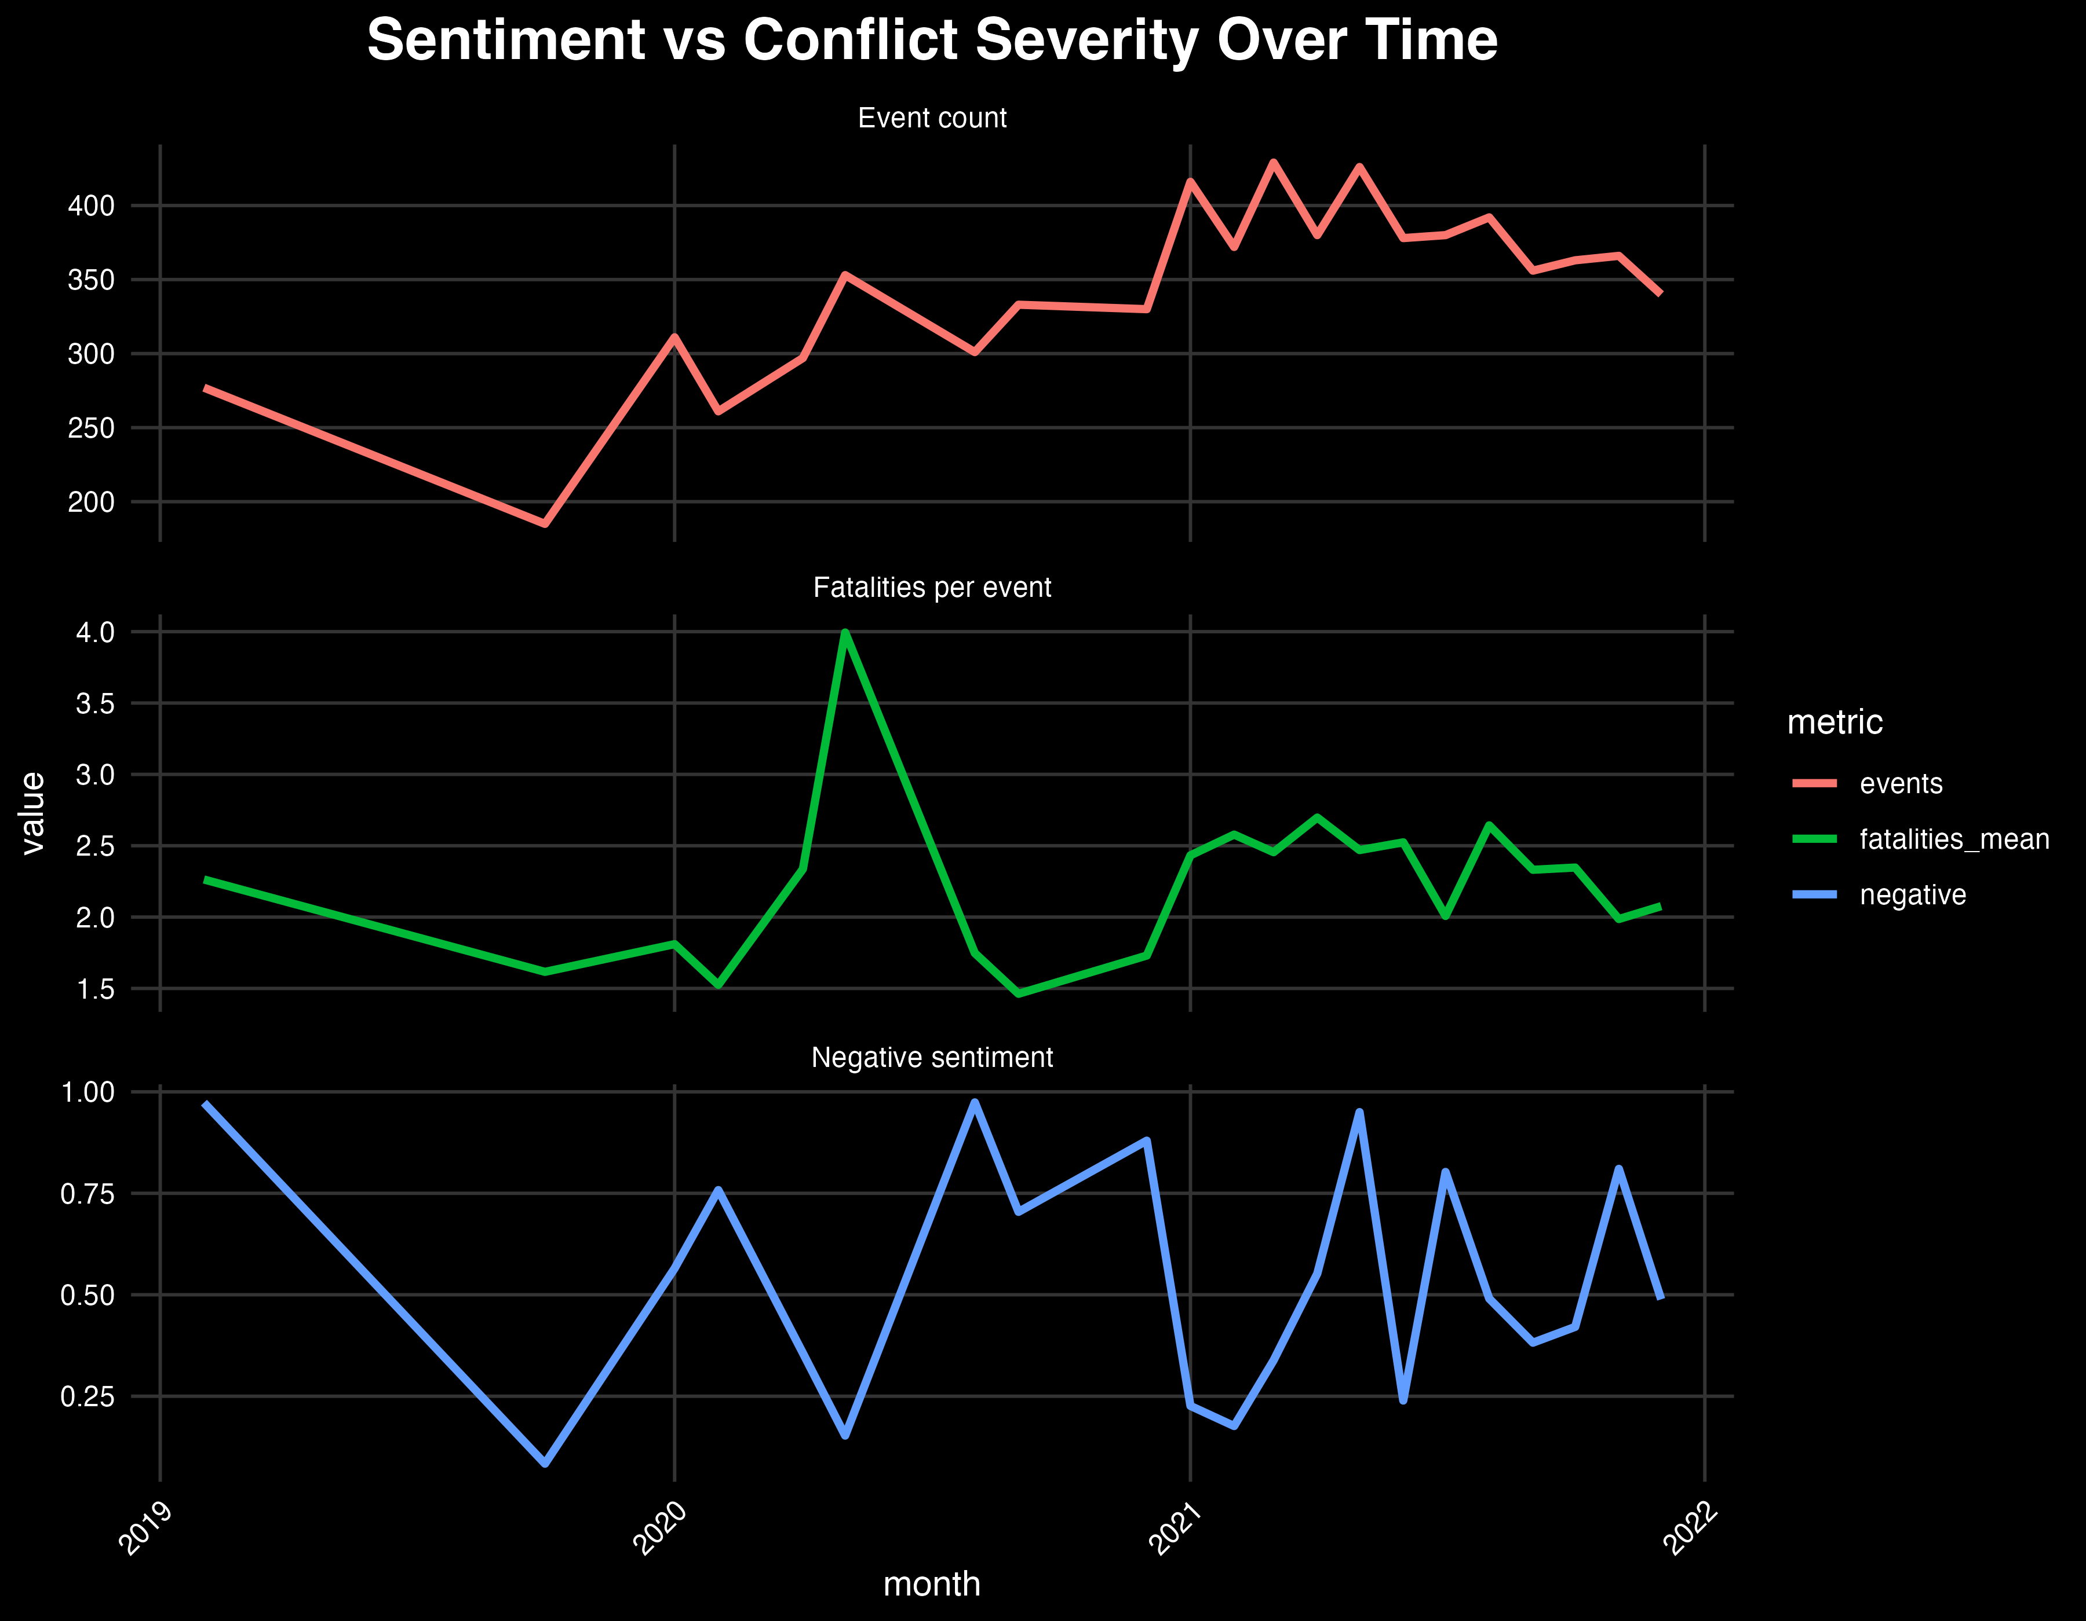
Results

